Slide 1


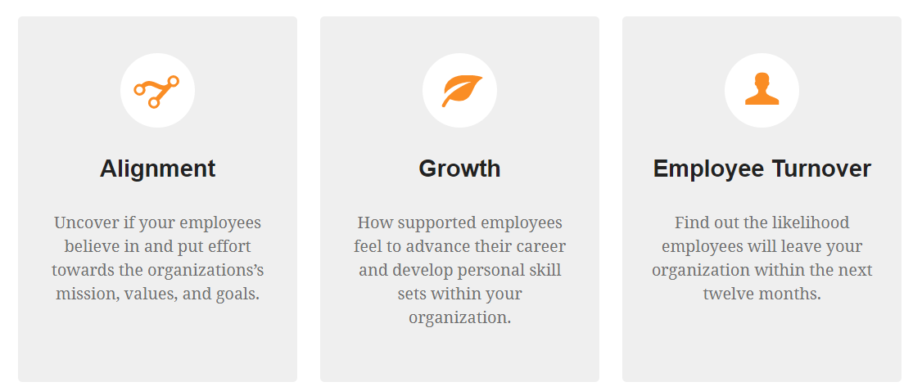
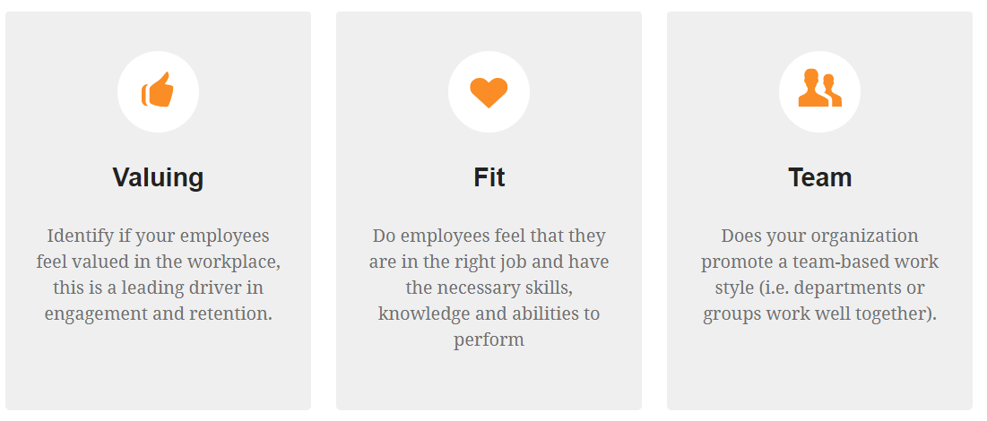
Rate Effectiveness and Importance
15-Minutes
Anonymous
and Confidential
Logo
Here
Do you believe in the mission and values?
Are you supported with your goals?
Do you feel valued for the work you do?
Is collaboration strong across teams?
Do you love the position you’re in?
Notes:
Share with employees
Add your logo

