Slide 1





Slide 2

Sparck
A personalized employee engagement
and recognition platform that helps
increase retention & performance!
Notes:
We’re passionate about igniting economic growth through power of positive human connection. We help employers increase retention with personalized recognition.

Slide 3
Employee
loyalty is at
an all-time low
10.3
7.9
MILLENNIALS have become
50% of the WORKFORCE
in 2020
AVERAGE JOB TENURE IN YEARS
1.6
BOOMERS
GEN X
MILLENNIALS
Source Information: Society of Human Resource Management (SHRM), Gallup, Management Association 2016, and U.S. Census Bureau
Notes:
dominating characteristic now since half the workforce is made up of millennials.

Slide 4

Employee
turnover
is expensive
Cost to replace each employee
Cost to replace each employee
$28,500
$325,000
Over half
of U.S. employees
are looking to leave their jobs
AVG U.S. SALARY
AVG TECHNICAL SALARY
Salary + Benefits
x 50% (SHRM)
Salary + Benefits
x 250% (Gallup)
$57,000
$130,000
Source Information: Society of Human Resource Management (SHRM), Gallup, NALP Foundation’s
2017 Update on Associate Attrition Report, Pay Scale, Salary.com and U.S. Census Bureau
Notes:
But what does engagement look like?

Slide 5

THE ENGAGEMENT
FACTOR
Highly engaged employees are 87% less likely to leave their company.
Employees who feel their voice is heard is 4.6x more likely to feel empowered to perform their best work.
Notes:
But what does engagement look like?

Slide 6

what is being measureD + characteristics
The #BeHeard survey looks at the extent to which employees feel passionate about their jobs, are committed to the organization, put discretionary
effort into their work and are willing to refer.
ENGAGED EMPLOYEE
Consistently exceed performance requirements
Feel a sense of belonging at the organization
Motivated to go the extra mile
Willing and happy to refer potential employees
Believe in support, and are committed to the goals and objectives of the organization
DISENGAGED EMPLOYEE
Lacks enthusiasm and initiative to meet goals
Tend to miss deadlines, late for work and break their promises
Are not motivated to help others or go above and beyond
Actively looking for a new job
Do not believe in support, and are committed to the goals and objectives of the organization

Slide 7
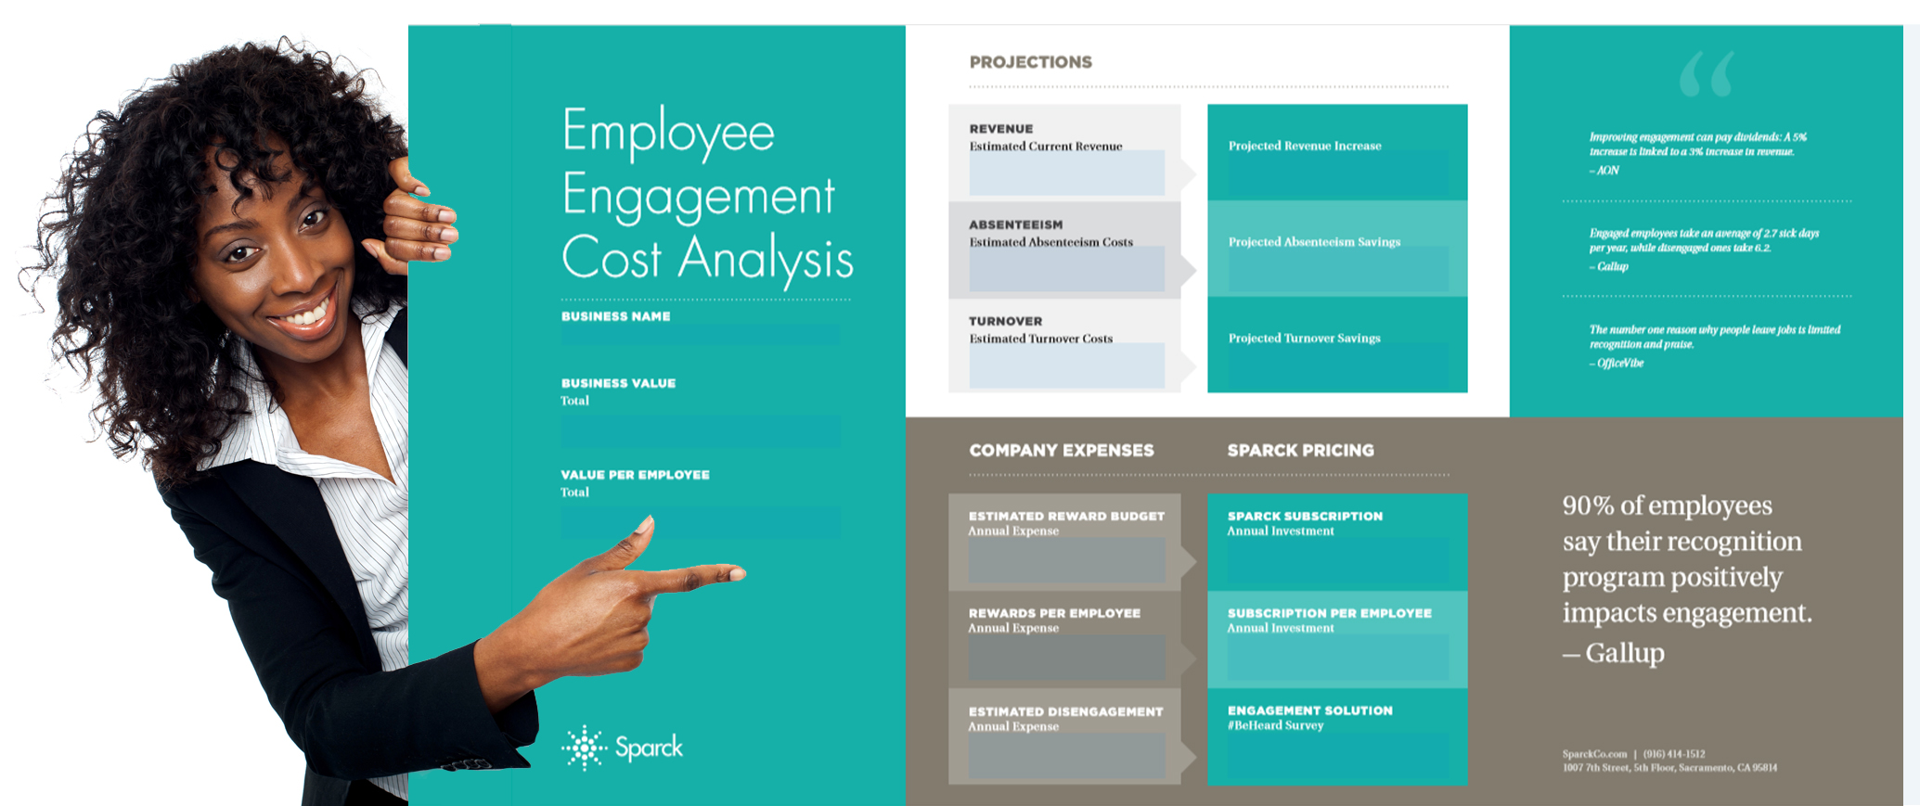
Increased engagement
will impact your bottom line!
Notes:
We want to look at engagement first. So we do an engagement cost analysis to see where you are now and where you could be with increased retention. In addition to retention, we look at things like your current revenue, disengagement costs to show you what increased engagement will look like and how it will impact your bottom line. We like to start with with engagement to create a benchmark. We can provide the free cost analysis and then use the #BeHeard survey to understand where you are now and where you can go in the future.

Slide 8


“
The Free Employee Engagement Cost Analysis Sparck provided was an
easy and effective way to communicate how an increase in engagement
can directly impact company performance. The customized one-page
overview was a great addition to the executive meeting to highlight our
specific numbers and outline a solution. I highly recommend this tool
to HR professionals who are mapping out their internal strategies.
Jennifer Hureaux, HR Manager
”
Hear from our clients

Slide 9



#BeHeard ENGAGEMENT SURVEY
Add
Logo
15
minutes
Anonymous and Confidential
Rate Effectiveness and Importance
ALIGNMENT
Do you believe
in the mission
and values?
GROWTH
Are you
supported with
your goals?
VALUING
Do you feel valued for the work you do?
TEAM
Is collaboration strong across teams?
FIT
Do you love
the position
you are in?
Notes:
Solution = #BeHeard Engagement Survey

Slide 10


Uncover
your employee engagement score
EMPLOYEE TURNOVER
Find out the likelihood employees will leave your organization
in within the next
12 months.
ALIGNMENT
Uncover if your employees believe in and put effort towards the organization’s mission, values,
and goals.
GROWTH
How supported employees feel to advance their career and develop personal skill sets within your organization.
VALUING
Identify if your employees feel valued in the workplace, this is a leading driver in engagement and retention.
TEAM
Does your organization promote a team-
based work style (i.e. departments or groups work
well together).
FIT
Do employees feel that they are in the right job and have the necessary skills, knowledge and abilities to perform.
Notes:
Alignment: The extent to which the employee believes in and puts effort toward this
organization’s mission, values and goals.

Slide 11
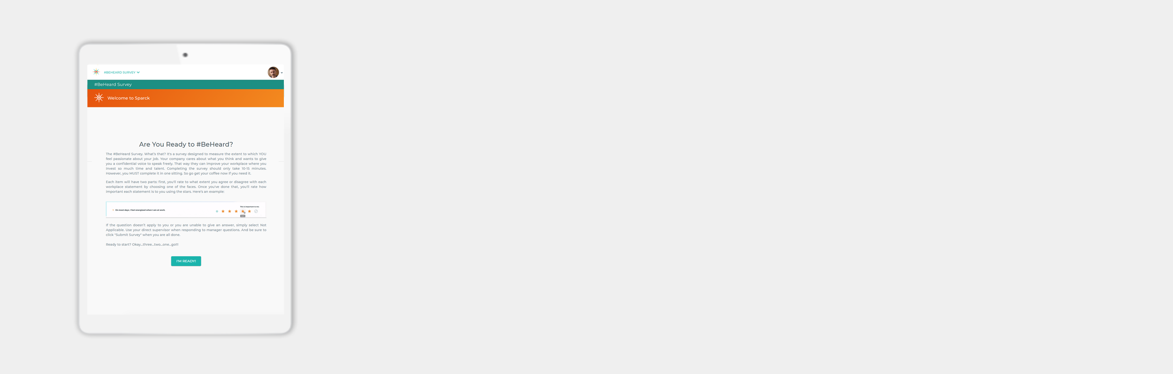
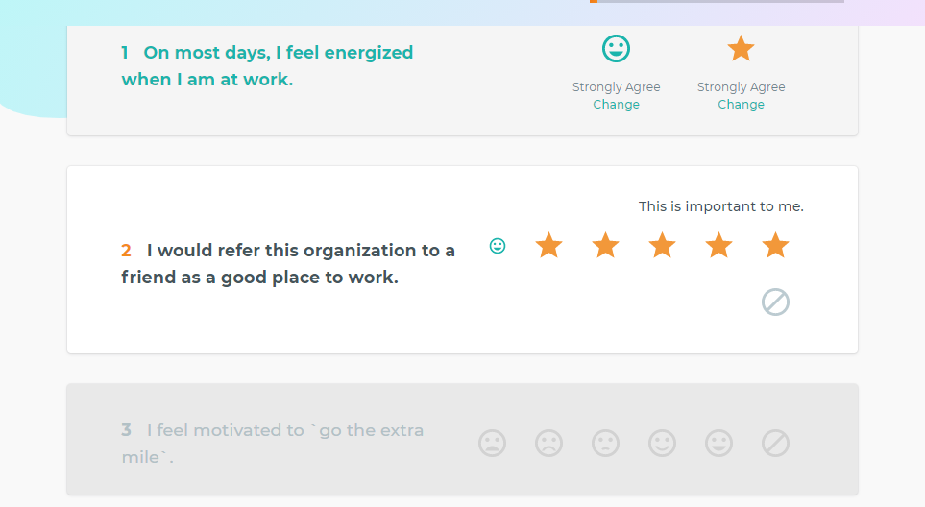
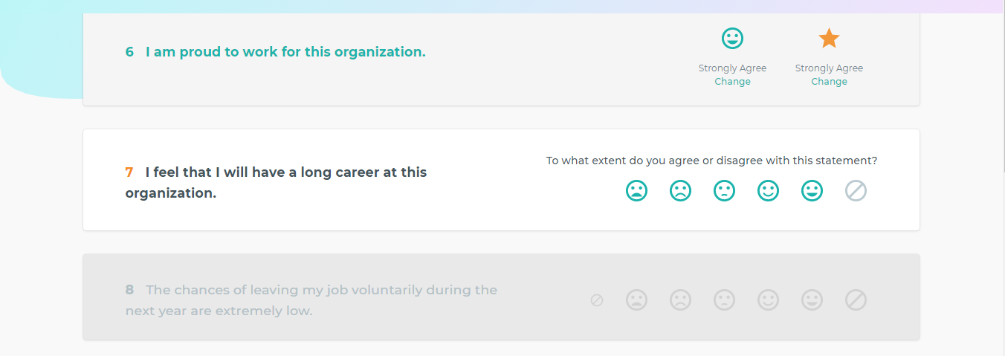

SURVEY FEATURES
Five-point likert scale
Dual rating for importance & effectiveness
Engagement score per demographic group
SURVEY VALIDATION
In partnership with Integral Talent Systems (ITS)
Helping employers since 1997
Developed from 10-years of research
.93 statistical reliability score for 19 items
Notes:
Dual rating score
Statistically validated
Survey developed by Integral Talent Systems (ITS)
Rates the effectiveness and importance of the relevant factors that affect engagement & turnover.

Slide 12

SAMPLE #BeHeard QUESTIONS
ENGAGEMENT
The extent to which employees feel passionate about their jobs, are committed to our organization, put discretionary effort into their work and are willing to refer. The following are sample questions for this index:
I care about the results that this organization achieves.
I feel that I will have a long career
at this organization.
FIT
The extent to which the employee feels that they are in the right job and have the necessary skills, knowledge and abilities to adequately perform in their role. The following sample questions advise Fit:
The type of work that I do leverages my personal strengths.
I have clearly defined goals for my job.
ALIGNMENT
The extent to which the employee believes in and puts effort toward this organization’s mission, values and goals. The following sample questions advise Alignment:
I have confidence in the direction that our organization is taking.

Slide 13
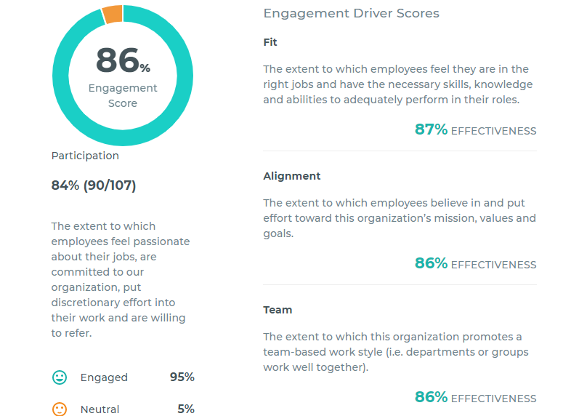

#BeHeard SURVEY REPORT
PREMIUM FEATURES
Engagement Scores
Anticipated Turnover
Engagement SWOT Analysis
Result-based recommendations
PREMIUM FILTERING OPTIONS
Location Ethnicity
Business Unit Generation
Tenure Department
Job Title Gender
Notes:
9 out of 10 managers who use this survey find they don’t even need a focus group because the results are so actionable.

Slide 14

Survey Launch Plan
Launch
Discuss internal messaging
Survey timeline and expectations
Employee experience
Initial email form executive
Sparck manages follow up until completion
Manage participation in real-time
1
2
3
4
Marketing Strategy
Engagement Results
Purpose: High Participation
Discuss communication channels
Schedule Company Q&A Call
#BeHeard reports will be generated
Summary of results
Actionable recommendations
#Beheard survey experience

Slide 15

“
This rigorous, data-driven measurement of employee engagement has helped multiple companies understand their workforce and implement the proper programs to drive engagement and performance.
– Jen Brown
”
CLIENT TESTIMONIALS
Notes:
Hear what other companies say about this survey!
In partnership with Integral Talent Systems, Sparck is able to measure how passionate employees feel about their jobs, are committed to the organization, and put discretionary effort into their work and are willing to refer. Employee engagement directly relates to productivity, revenue, absenteeism, turnover, customer satisfaction and other company metrics.

Slide 16

THANK YOU

